Slide 1
ENSF 612
Project Layout
Automated Classification of Software Issue Reports Using Machine Learning Techniques: An Empirical Study
Presented by:
GROUP - 1
Taruneesh Sachdeva #30114398
Sanyam #30118797
Neha Singh #30109044

Slide 2
Project Layout
Problem
Software users often submit issue reports to record the problems they face in using a software and they often misclassify an improvement request as a BUG or a NUG (which is all except bug) which causes valuable time of developers. Hence automated classification is used to categorize the issue using machine learning techniques.
Approach
We will construct classifiers that can automatically identify if an issue is a BUG or NUG, based on the below:
F-Measure or F1-score,
Average accuracy, and
Weighted average F measure.
The issue reports are taken from three projects i.e. HttpClient4, Lucene5, and Jackrabbit6, which belong to three bug tracking systems: Bugzilla1, Gnats2 and Jira3, respectively.

Slide 3
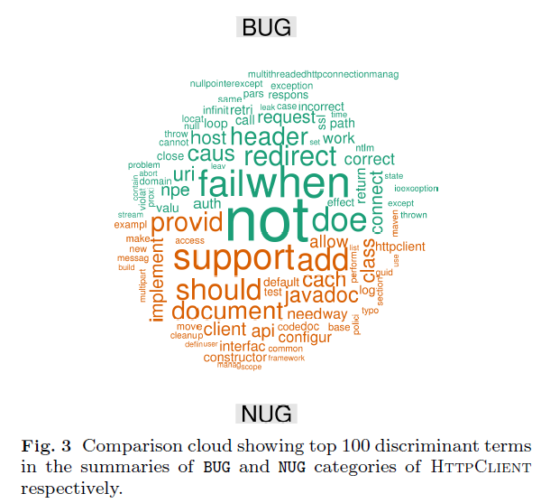
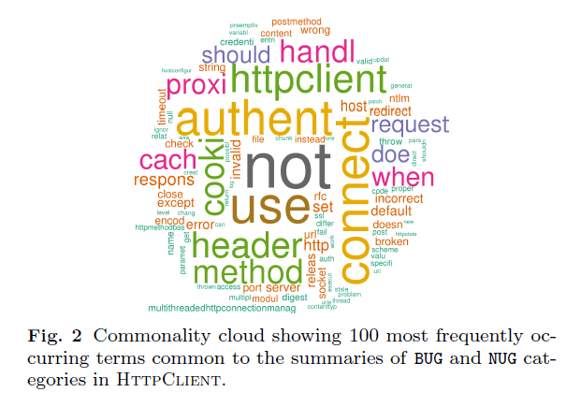
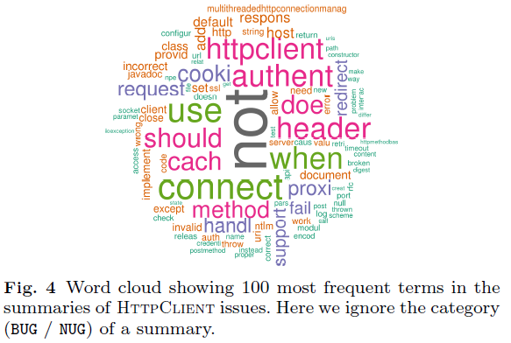
We will extend our dataset by 1000 issue reports from one of the above bug tracking systems and will manually classify them.
Figure 2 shows, the summaries in each category share many common terms.
Figure 3 shows, the most frequent terms in a BUG report are not always the most frequent ones in a NUG report.
Figure 4 shows that within a large enough set of the most frequent terms in Http-Client summaries, the top discriminative terms from both BUG and NUG categories are present.

Slide 4
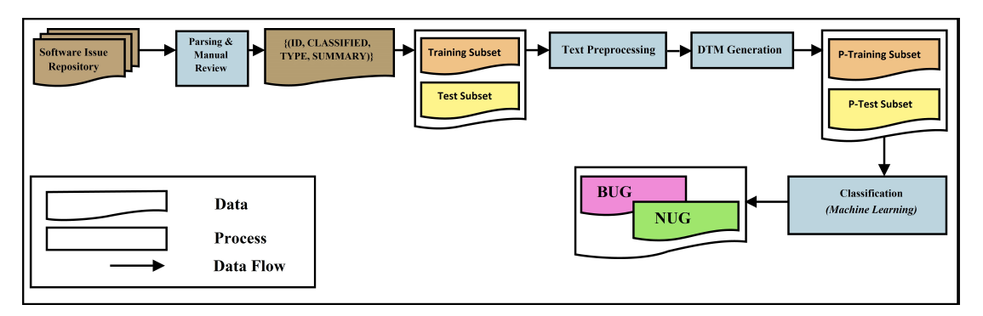
Trained models are then tested on the test data and calculated F-measure values are compared to obtain the best model.
Fig: Proposed approach for automated classification of issue reports. k-fold cross-validation is used.
On the extended dataset, the machine learning models naive Bayes (NB), linear discriminant analysis (LDA), k-nearest neighbors (kNN), support vector machine (SVM) with various kernels, decision tree (DT) and random forest (RF) are trained using k-fold cross-validation.

